Slide 1





Web-Based Kombolcha Textile Online Shopping Platform
Group 1:
HABTAMU AYENEW FEKADU | WOUR/1200/13
DANIEL TADESSE BEKELE | WOUR/0693/13
ETSUBDINK GASHAW MEQUANNT | WOUR/4067/13
EYERUS TESFAYE GEBREMESKEL | WOUR/0964/13
Oct-2024 G.C

Slide 2
Agenda
Introduction
01
Explain the need for an eCommerce platform.
Mention the technologies used (Next.js, TypeScript, etc.).
•Statement of the Problem
02
Key challenges include limited access
Objective of the project
03
•General objective
Specific Objectives
Project Scope and Limitation
04
Highlight the boundaries of the project
which are outside the scope

Slide 3
Agenda
05
Existing System vs. New System
06
Key Diagrams (Use Cases, Architecture)
07
08
•Conclusion

Slide 4
01
Introduction
Background:
E-commerce is a rapidly growing industry in Ethiopia,
The project is a “Kombolcha Textile Online Shopping Platform”, providing a dedicated platform for buying and selling textile products, such as garments, fabrics, and accessories.
Our primary objective is to develop an exceptional online marketplace that serves three distinct user groups, each with unique roles and experiences:
Admin
Clients
Merchants

Slide 5

Statement of the Problem
Ethiopia's eCommerce sector is still in its early stages.
One major issue is that many local businesses, including Kombolcha Textile Share Company, rely on traditional selling methods, limiting their ability to reach a wider audience and capitalize on online opportunities.
Key challenges include limited access to modern payment systems.
Consumers also encounter difficulties in accessing a diverse range of textile products conveniently.

Slide 6
Project Objectives
General Objectives:
main objective of this project is to build an efficient and user-friendly Kombolcha Textile Online Shopping Platform tailored to the local market.
Specific Objectives:
1. Integration with Local Payment Systems:
2. Localization and Cultural Sensitivity:
3. Mobile Optimization
.....

Slide 7
Feasibility
Economic Feasibility
Schedule Feasibility
Market Potential
Cost Structure
Financial Projections
Project Scope
Resource Allocation
Contingency Planning
Technical Feasibility
Political Feasibility
Technology Stack
Development Expertise
Integration
Stakeholder Alignment
Regulatory Compliance
Feasibility
Operational Feasibility
Business Processes
Resource Availability
Risk Management

Slide 8
Project Scope
SCOPE
Development of the e-commerce platform with functionalities for clients, merchants.
Integration of secure payment gateways.
Development of a communication system for messaging and notifications.
Implementation of analytics and reporting tools.
Design of a user-friendly interface for all user types.

Slide 9
Limitations
Geographical Focus: The platform will primarily serve the Ethiopian market, and its reach may be limited to regions with reliable internet connectivity.
Language and Cultural Barriers: While the platform will be designed with local language and cultural considerations, there may be limitations in catering to a diverse range of users.
Resource Constraints: The availability of financial resources, human capital, and technological capabilities may influence the project's scope and timeline.

Slide 10
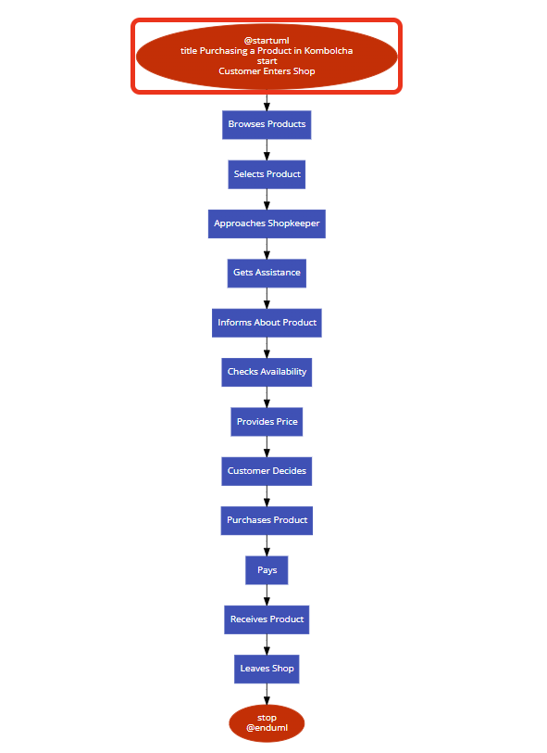

Existing System VS Proposed
Existing System
Proposed e-commerce website
Real-time product updates.
Secure transactions.
Responsive UI with Tailwind CSS

Slide 11
Existing System VS Proposed
Existing System
fully local system.

Slide 12
Esential System Use Case
Diagram
E-commerce
add new product
Register
New user
Reply feedback
product search and view item
You can simply impress your audience an add a unique and appeal to your Reports and Presentations with our Templates. Get a modern PowerPoint Presentation that is beautifully designed. I hope and I believe that this Template will your Time, Money and Reputation.
Merchant
post feedback
add and reject user
Registered user
make purchase
add merchant
checkout
admin
submit review
view report
access order

Slide 13
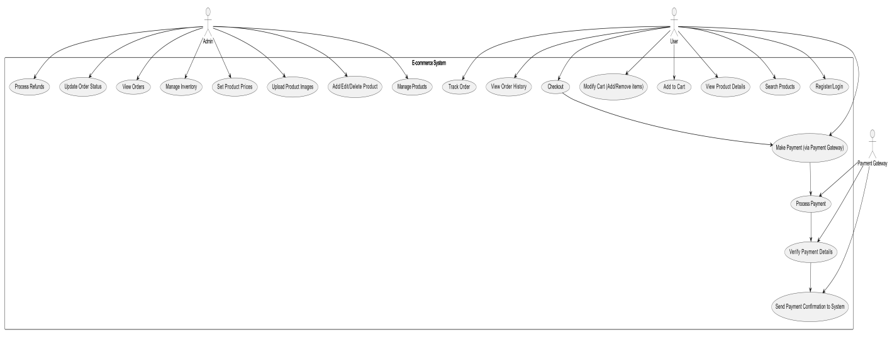
System Use Case
Diagram
You can simply impress your audience and add a unique and appeal to your Reports and Presentations with our Templates. Get a modern PowerPoint Presentation that is beautifully designed. I hope and I believe that this Template will your Time, Money and Reputation.
Simple PowerPoint

Slide 14
Thank you

